Slide 1
A Novel Convolutional Neural Network for Breast Cancer Diagnosis
BATCH NUMBER: D2
Under the guidance of :
Dr. U. Rajyalakshmi _{M.Tech., Ph.D.,}
Professor, Department of ECE
Presented by:
U. Padma - 18A91A04N4
Ch. Rajeswari - 18A91A04I5
B. Dharmendra - 18A91A04I3
S. Sanjay - 18A91A04M8

Slide 2


CONTENTS
Base Paper
Abstract
Introduction
Problem Statement
Project Setup
Basic CNN Architecture
Proposed Methodology
Results
Conclusion/Future Scope
References

Slide 3
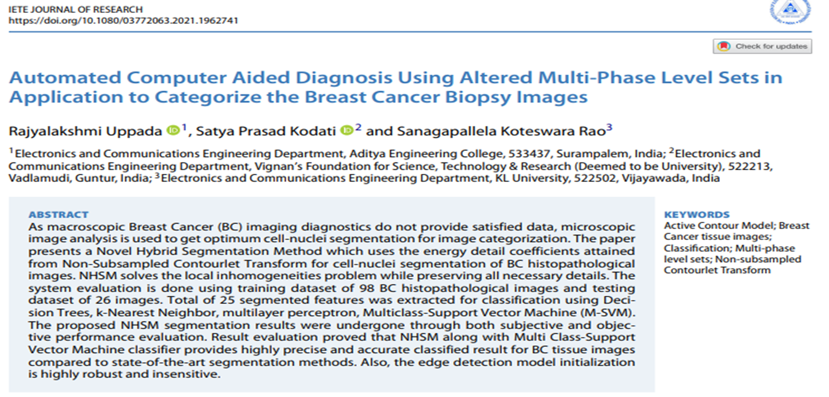
BASE PAPER

Slide 4
ABSTRACT
Breast cancer (BC) is the second leading causes of death across the world in women.
Early and quick diagnosis of breast cancer requires new deep learning and transfer learning techniques.
Our project implements a Novel Convolutional Neural Network (CNN) model based on Transfer learning for the classification of biopsy tissue images.
The features are extracted using DenseNet-201 pre-trained model and then fed into different layers to get better performance.
To evaluate the proposed model various metrics are calculated and compared them with previous methods.

Slide 5
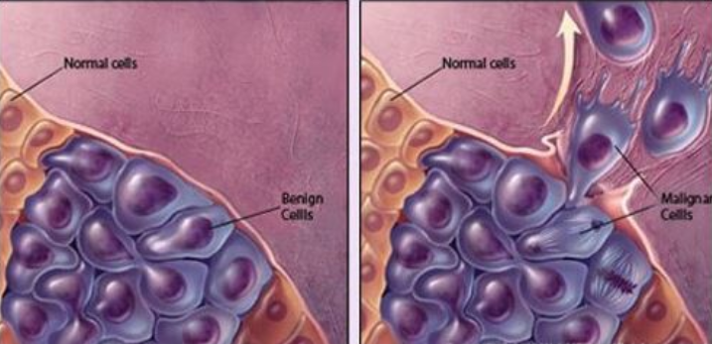
INTRODUCTION
Breast cancer is a disease in which cells in the breast grow out of control.
There are two general types of tumors namely: Benign and Malignant.
Benign tumors include fibrocystic changes, cysts, trauma, fat necrosis and lactation changes.
Malignant tumors may be invasive or non-invasive. These are the cancerous tumors.

Slide 6
INTRODUCTION
Early detection of breast cancer helps in better selection of treatment and prevents risk on human life.
Computer Aided Diagnosis (CAD) can detect early cancers and directs attention to unnoticeable findings in diagnostic images with reduced complexity and time.
Traditional CAD methods rely on manually extracted features, but the process can be tedious, difficult and non-generalizable.
An alternate method for feature extraction is to use Convolutional Neural Networks, which helps our model to automatically detects the important features without any human supervision.

Slide 7
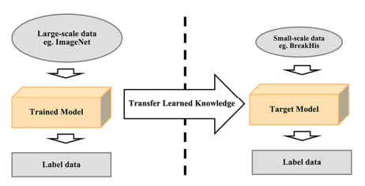
INTRODUCTION
There are two types in CNN model implementation: Training from scratch and Transfer learning.
Training from scratch requires a lot of computational power and take long time to collect and train the model because of complex architecture.
The solution is to reuse a pre-trained model as feature extractor.

Slide 8

PROBLEM STATEMENT
In today’s scenario, we have too much delay and inaccuracy in the diagnosis results provided by clinical centers.
The traditional forms of digital pathology has been facing obstacles such as the high cost of implementing and operating the technology, insufficient productivity for high-volume clinical routines etc.
In order to overcome these disadvantages of traditional methodology, Our system proposes an easy approach for clinical examination for breast cancer diagnosis prediction using Convolutional Neural Network.

Slide 9
PROJECT SETUP
About the Dataset:
We used a BreakHis dataset that consists of minuscule biopsy pictures of malignant and benign breast tumors.
Installation Steps:
Install Python 3.8.2
Install all required libraries such as PIL, keras, numpy, tqdm, matplotlib, sklearn, tensorflow.
Language Used: Python
Framework Used: Keras
Web Application: Jupyter Notebook

Slide 10
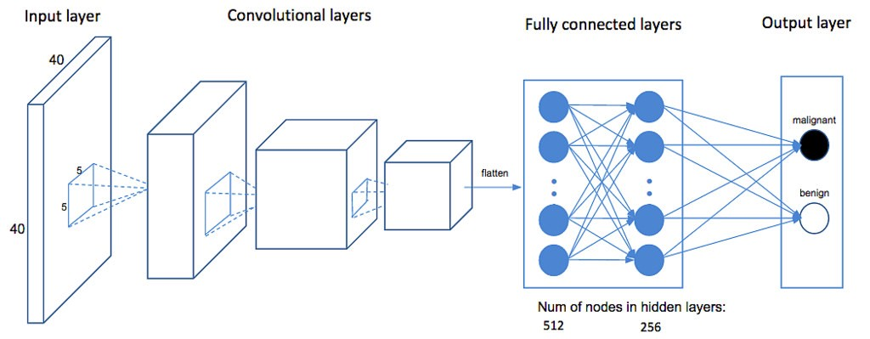
Basic CNN Architecture
Convolutional Layer: The first layer of a CNN is always a Convolutional Layer. It apply a convolution operation to the input, and passing the result to the next layer.
Dropout Layer: Dropout layer prevent overfitting on the training data. It works by randomly setting outgoing edges of hidden units to ‘0’ at each update of training phase.
Pooling: Pooling is used to reduce the dimensions of the features.
Flatten: Flattening converting the data into a 1-dimensional array for inputting it to the next layer.
Fully Connected Layer: Fully connected layers which compiles the data extracted by previous layers to form the final output.
Output Layer: It is responsible for producing the final result.

Slide 11
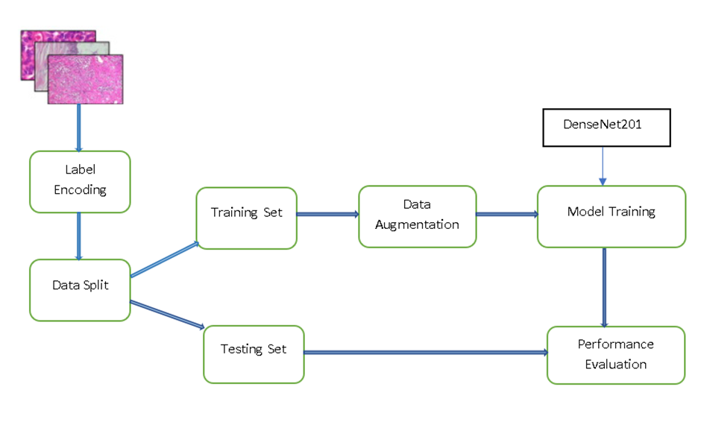
PROPOSED METHODOLOGY
BLOCK DIAGRAM

Slide 12
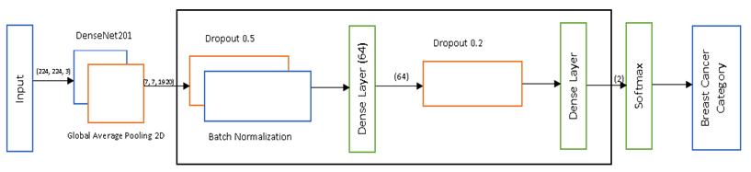
PROPOSED METHODOLOGY
DenseNet-201
This model consists of a total 201 deep CNN layers where each layer is arranged in such a way that it can solve overfitting issues while dealing with a small dataset and also solves the gradient descent problem. Compared to the AlexNet, GoogleNet and ResNet architectures, the DenseNet-201 pre-trained model will derive more complicated and essential features.

Slide 13
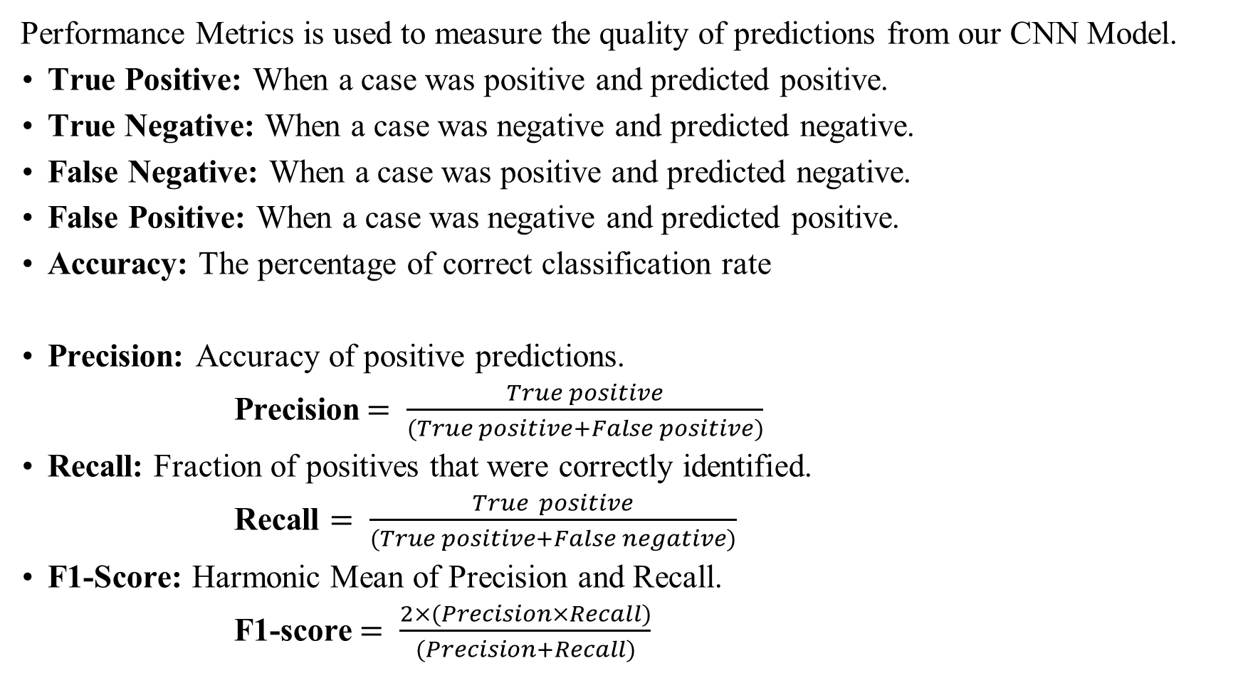
Performance Metrics
Performance Metrics is used to measure the quality of predictions from our CNN Model.
True Positive: When a case was positive and predicted positive.
True Negative: When a case was negative and predicted negative.
False Negative: When a case was positive and predicted negative.
False Positive: When a case was negative and predicted positive.
Accuracy: The percentage of correct classification rate
Precision: Accuracy of positive predictions.
Precision$= \frac{True positive}{(True positive+False positive)}$
Recall: Fraction of positives that were correctly identified.
Recall $= \frac{True positive}{(True positive+False negative)}$
F1-Score: Harmonic Mean of Precision and Recall.
F1-score$= \frac{2×(Precision×Recall)}{(Precision+Recall)}$
Accuracy $= \frac{(True positive+True negative)}{Number of samples}×100$

Slide 14
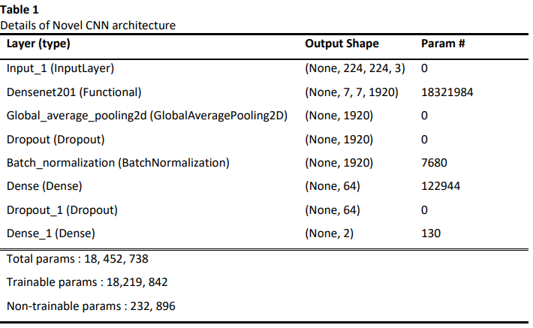
RESULTS
Given below is the model summary which gives output shape and the parameters involved in each layer.

Slide 15
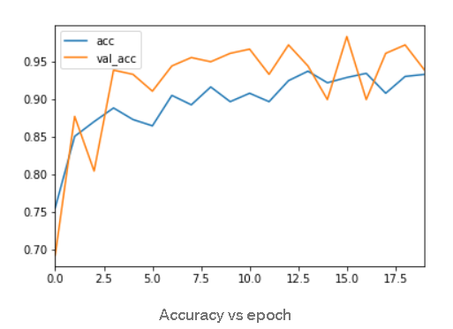
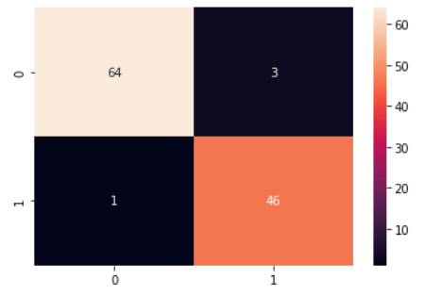
RESULTS
Accuracy | Precision | Recall | F1-score | ROC-AUC
99.75% | 0.93 | 0.97 | 0.95 | 0.88

Slide 16
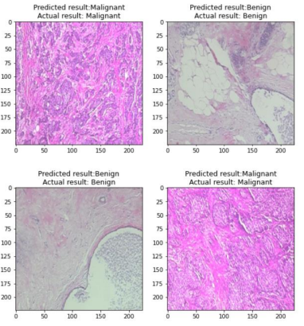
Reference | Year | Dataset | Methods | Accuracy
Spanhol [2] | 2016 | BreakHis | SVM, Random Forest, QDA, Nearest Neighbour | Accuracy: 80% - 85%
Asri [3] | 2016 | Wisconsin Dataset | SVM | Accuracy:97.13%
Rakhlin[4] | 2018 | BACH | ResNet-50 | Accuracy: 87.2%
Spanhol[5] | 2017 | BreakHis | Modified AlexNet | Accuracy: 81.5%-86.3%
Nguye[6] | 2019 | BreakHis | Inception and ResNet CNN | Accuracy: 96.4%
Kassani[7] | 2020 | BACH | Pretrained VGG19, MobileNet, DenseNet with Multi-Layer Perception | Accuracy:92.71%
Alkassar[8] | 2021 | BreakHis | Xception and DenseNet CNNs | Accuracy: 99%
Proposed Model | 2022 | BreakHis | Modified DenseNet-201 | Accuarcy: 99.75%

Slide 17
CONCLUSION/FUTURE SCOPE
The proposed Novel CNN technique helps radiologists and doctors for detecting breast cancer in short time with more accuracy.
The performance was evaluated using different performance metrics. It shows an testing accuracy of 99.75%.
In future studies, more samples will be collected to improve generalization as the accuracy can be further improved with a larger dataset.

Slide 18
REFERENCES
1. RajyalakshmiUppada, Satya Prasad Kodati & Sanagapallela Koteswara Rao (2021) Automated Computer Aided Diagnosis Using Altered Multi-Phase Level Sets in Application to Categorize the Breast Cancer Biopsy Images, IETE Journal of Research.
2. Spanhol FA, Oliveira LS, Petitjean C, Heutte L (2016) A dataset for breast cancer histopathological image classifcation. IEEE Trans Biomed Eng 63(7):1455–1462.
3. Asri, H.; Mousannif, H.; Al Moatassime, H.; Noel, T. Using Machine Learning Algorithms for Breast Cancer Risk Prediction and Diagnosis. Procedia Comput. Sci. 2016, 83, 1064–1069.
4. Rakhlin, A.; Shvets, A.; Iglovikov, V.; Kalinin, A.A. Deep Convolutional Neural Networks for Breast Cancer Histology Image Analysis. In Proceedings of the 15th International Conference, ICIAR 2018.
5. F. A. Spanhol, L. S. Oliveira, P. R. Cavalin, C. Petitjean and L. Heutte, "Deep features for breast cancer histopathological image classification," 2017 IEEE International Conference on Systems, Man, and Cybernetics (SMC), 2017, pp. 1868-1873.
6. Vo DM, Nguyen N-Q, Lee S-W (2019) Classification of breast cancer histology images using incremental boosting convolution networks. Inf Sci 482:123–138.
7. kassani, S.H.; Kassani, P.H.; Wesolowski, M.J.; Schneider, K.A.; Deters, R. Classification of Histopathological Biopsy Images Using Ensemble of Deep Learning Networks. arXiv 2019.
8. Alkassar, S.; Jebur, B.A.; Abdullah, M.A.M.; Al-Khalidy, J.H.; Chambers, J.A. Going Deeper: Magnification- Invariant Approach for Breast Cancer Classification Using Histopathological Images. IET Comput. Vis. 2021.

Slide 19


Aditya Engineering College (A)
THANK YOU

